Slide 1
React
Nisar Ahmed Siddiqui

Slide 2
React - Introduction
React is a view layer library, not a framework like Backbone, Angular etc.
Developed by Facebook
You can't use React to build a fully-functional web app

Slide 3
React.JS History
Current version of React.JS is V18.0.0 (April 2022).
Initial Release to the Public (V0.3.0) was in July 2013.
React.JS was first used in 2011 for Facebook's Newsfeed feature.
Facebook Software Engineer, Jordan Walke, created it.
Current version of create-react-app is v5.0.1 (April 2022).
create-react-app includes built tools such as webpack, Babel, and ESLint.
Notes:
Let’s walk through an example of creating a React app with create-react-app (CRA) to explain how Webpack, Babel, and ESLint work.
Scenario: You Create a React App
You run:
npx create-react-app my-app cd my-app npm start
You open src/App.js and modify it with this modern React code:
import React from 'react'; const App = () => { const greeting = "Hello, React!"; return <h1>{greeting}</h1>; }; export default App;
You add a CSS file (App.css) and some assets (e.g., logo.png) to make your app look better.
1. Webpack in Action
When you run npm start, Webpack:
Bundles Files: Combines App.js, App.css, and any other files (e.g., logo.png) into a single JavaScript bundle that the browser can understand.
Example: If you add another component (e.g., Header.js), Webpack automatically includes it in the build without needing manual imports.
Serves Your App: Starts a development server and automatically reloads the browser when you save changes (thanks to Hot Module Replacement, or HMR).
Optimizes for Production: When you run npm run build, Webpack minimizes and optimizes your code, removing unnecessary parts and splitting it into smaller chunks.
Example: Large dependencies like react might go into a separate chunk (vendor.js), improving app loading speed.
2. Babel in Action
Babel ensures that your modern JavaScript and JSX syntax work in all browsers:
Transpiling JSX: Converts <h1>{greeting}</h1> into a plain JavaScript React.createElement call.
Example: const App = () => <h1>Hello, React!</h1>; becomes: const App = () => React.createElement("h1", null, "Hello, React!");
Backward Compatibility: If you use modern JavaScript features like optional chaining (obj?.prop), Babel converts them to older syntax.
Example: const x = obj?.value; becomes something like: const x = obj === null || obj === undefined ? undefined : obj.value;
This ensures your app works even in older browsers like Internet Explorer 11.
3. ESLint in Action
While coding, ESLint helps maintain code quality:
Linting Errors: If you accidentally write something like:
const App = () => { let greeting = "Hello, React!"; greeting = ; return <h1>{greeting}</h1>; }; ESLint flags the missing assignment (greeting = ;) and warns you in the terminal or your code editor (e.g., VSCode).
Code Style Enforcement: Suppose you write code like this:
const App=()=>{return (<h1> Hello, React!</h1>);} ESLint suggests formatting it to match a consistent style:
const App = () => { return <h1>Hello, React!</h1>; };
Prevents Common Errors: If you declare a variable (let greeting;) but never use it, ESLint warns about unused variables.
Putting It All Together
When you run:
npm start:
Webpack bundles your code and assets into a development-friendly format.
Babel transpiles modern JavaScript and JSX for browser compatibility.
ESLint runs checks and warns about code issues.
npm run build:
Webpack optimizes your code and assets for production.
Babel ensures backward compatibility for browsers.
ESLint ensures the final build has no linting issues.
Outcome:
Your app, including App.js, App.css, and assets, runs smoothly in development and is optimized for production, all while adhering to modern coding standards.

Slide 4
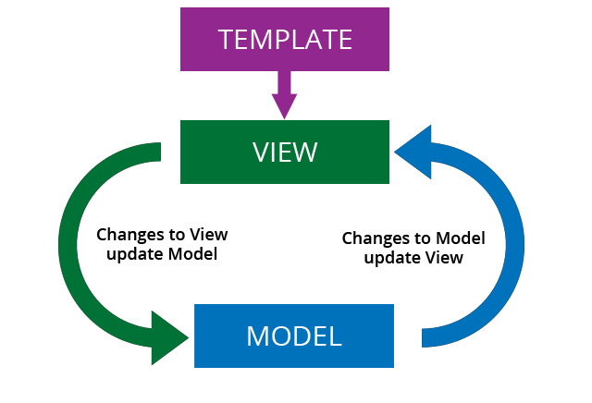
Why React?
Complexity of two-way data binding
Bad UX from using "cascading updates" of DOM tree
A lot of data on a page changing over time
Complexity of Facebook's UI architecture
Shift from MVC mentality
Notes:
Vite is a modern alternative to CRA that replaces Babel and Webpack with faster and more efficient tools like esbuild and Rollup. While CRA focuses on a traditional build system, Vite leverages the latest browser features and tools to significantly improve speed and developer experience. For ESLint, both can use the same tool, but Vite requires manual integration.

Slide 5
React - Installation

Slide 6
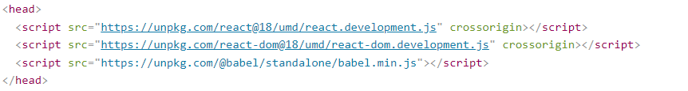
React Getting Started - React Directly in HTML
The quickest way start learning React is to write React directly in your HTML files.
Start by including three scripts, the first two let us write React code in our JavaScripts, and the third, Babel, allows us to write JSX syntax and ES6 in older browsers.

Slide 7
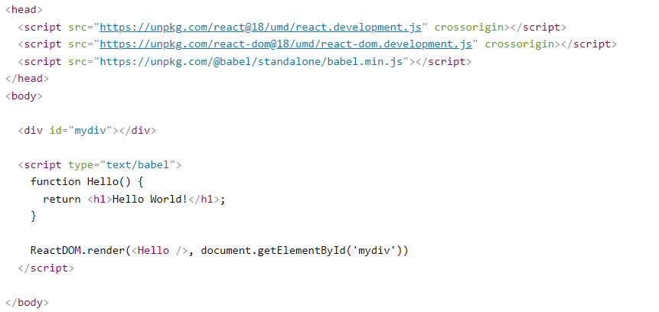
Hello World - Example

Slide 8

React Getting Started - React Environment
If you have npx and Node.js installed, we can create a React application by using create-react-app.
Run this command to create a React application named my-react-app:
The create-react-app will set up everything you need to run a React application.
Run this command to run the React application my-react-app:
Notes:
Create React App is a comfortable environment for learning React, and is the best way to start building a new single-page application in React. It sets up your development environment so that you can use the latest JavaScript features, provides a nice developer experience, and optimizes your app for production.

Slide 9
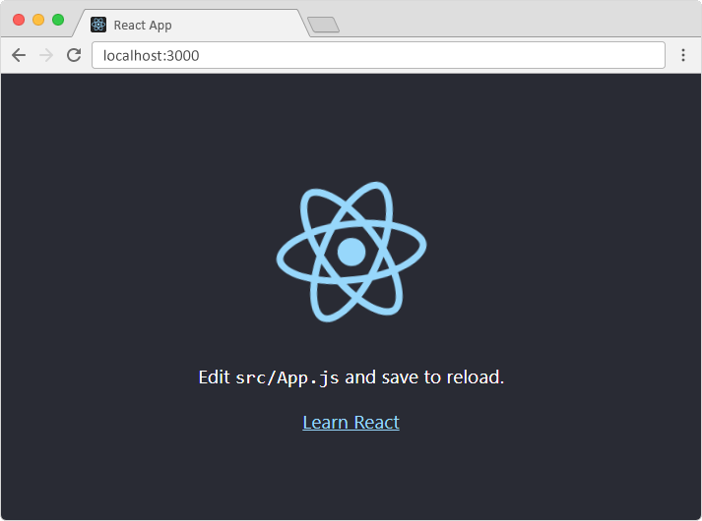
Result – First React App
A new browser window will pop up with your newly created React App! If not, open your browser and type localhost:3000 in the address bar.

Slide 10
React Basics

Slide 11
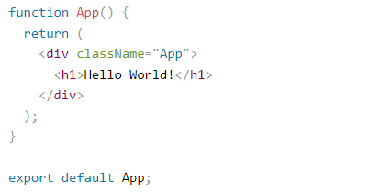
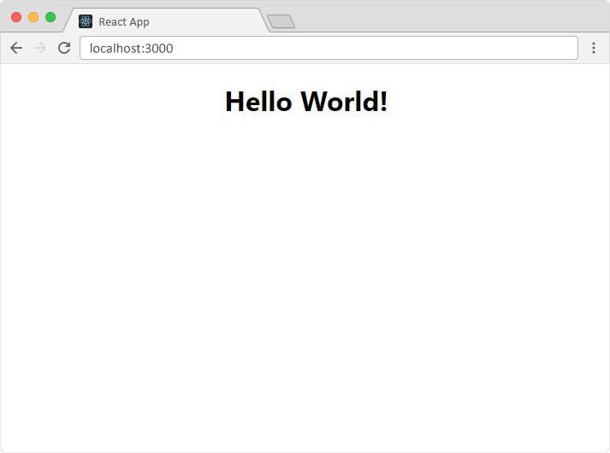
Hello World React Application
Inside the src folder there is a file called App.js: lets modify that, remove all the content and replace with the following:

Slide 12
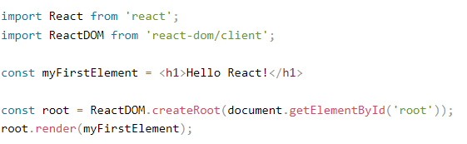
Lets start from scratch
Remove all the files from src folder, except index.js, and modify its content:

Slide 13
React Render HTML
React's goal is in many ways to render HTML in a web page.
React renders HTML to the web page by using a function called ReactDOM.render().

Slide 14
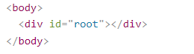
The Render Function
The ReactDOM.render() function takes two arguments, HTML code and an HTML element.
The purpose of the function is to display the specified HTML code inside the specified HTML element.
But render where?
There is another folder in the root directory of our React project, named "public". In this folder, there is an index.html file.
If we analyze the code inside the index.html, we can notice there is a single div:

Slide 15
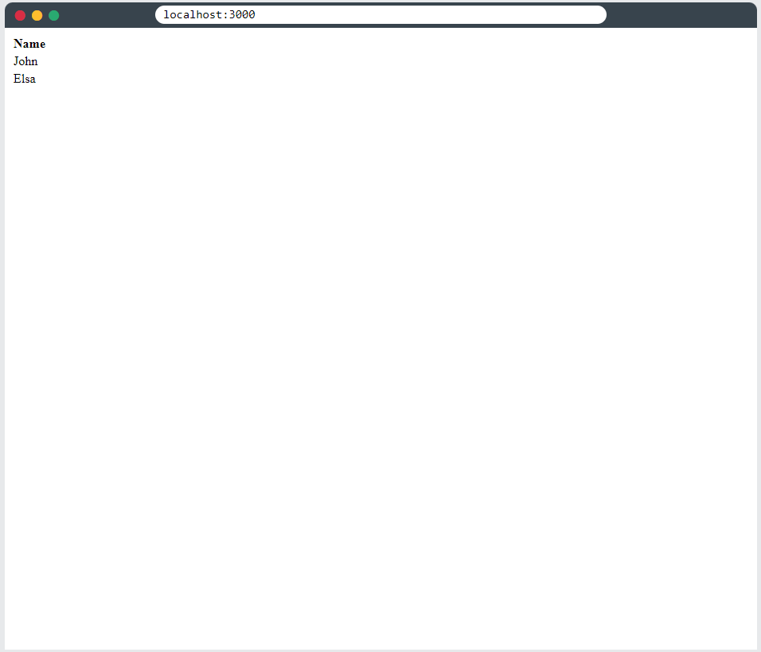
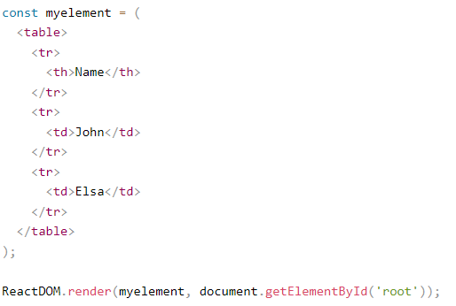
Example
Create a variable that contains HTML code and display it in the "root" node:

Slide 16
The Root Node
The root node is the HTML element where you want to display the result.
It is like a container for content managed by React.
It does NOT have to be a <div> element and it does NOT have to have the id='root':

Slide 17
React JSX
JSX stands for JavaScript XML.
JSX allows us to write HTML in React.
JSX makes it easier to write and add HTML in React.

Slide 18
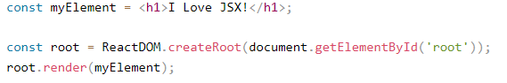
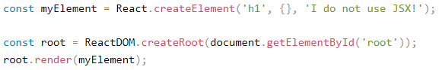
Coding JSX
JSX allows us to write HTML elements in JavaScript and place them in the DOM without any createElement() and/or appendChild() methods.
JSX converts HTML tags into react elements.
Here are two examples. The first uses JSX and the second does not:
Notes:
As you can see in the first example, JSX allows us to write HTML directly within the JavaScript code.
JSX is an extension of the JavaScript language based on ES6, and is translated into regular JavaScript at runtime.

Slide 19
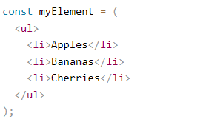
Expressions in JSX
With JSX you can write expressions inside curly braces { }.
The expression can be a React variable, or property, or any other valid JavaScript expression.
Inserting a Large Block of HTML

Slide 20
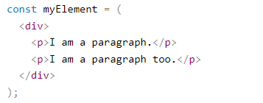
One Top Level Element
The HTML code must be wrapped in ONE top level element.
So if you like to write two paragraphs, we must put them inside a parent element, like a div element.

Slide 21
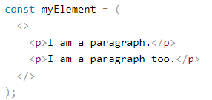
Fragment
We can use a "fragment" to wrap multiple lines. This will prevent unnecessarily adding extra nodes to the DOM.
A fragment looks like an empty HTML tag: <></>.

Slide 22
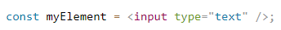
Elements Must be Closed
JSX follows XML rules, and therefore HTML elements must be properly closed.
Close empty elements with />

Slide 23
Attribute class = className
The class attribute is a much used attribute in HTML, but since JSX is rendered as JavaScript, and the class keyword is a reserved word in JavaScript, we are not allowed to use it in JSX.
JSX solved this by using className instead.
When JSX is rendered, it translates className attributes into class attributes.

Slide 24
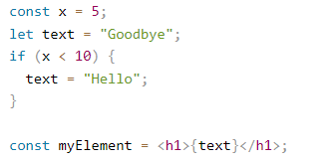
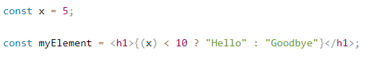
Conditions - if statements
React supports if statements, but not inside JSX.
To be able to use conditional statements in JSX, you should put the if statements outside of the JSX, or you could use a ternary expression instead:

Slide 25
React – Virtual DOM

Slide 26
Virtual DOM
The virtual DOM is used for efficient re-rendering of the DOM
React aims to re-render the virtual tree only when the state changes
Uses 2 virtual trees (new and previous) to find differences and batch update real DOM
Observes data changes (setState) and does dirty-checking to know when to re-render component
Whenever possible, does not update entire component in real DOM - only computes a patch operation that updates part of the DOM
Notes:
To understand the virtual DOM and learn why React implements it, let’s first refresh our knowledge of what the actual browser DOM is.
Normally, whenever a user requests a webpage, the browser receives an HTML document for that page from the server. The browser then constructs a logical, tree-like structure from the HTML to show the user the requested page in the client.
This tree-like structure is called the Document Object Model, also known as the DOM. It is a structural representation of the web document as nodes and objects, in this case, an HTML document.
The DOM serves as an interface for the web document so that JavaScript and other scripting languages can access, manipulate, and programmatically interact with the document’s content. For example, developers can use DOM APIs to add or remove elements, modify their appearance, and perform user actions on web elements.

Slide 27
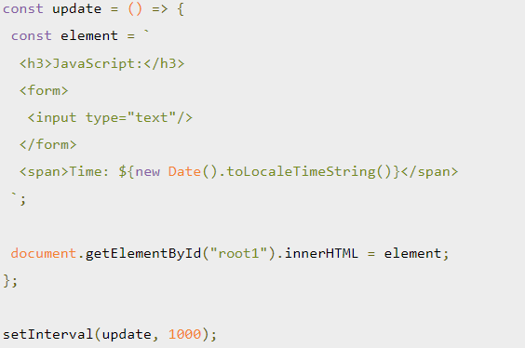
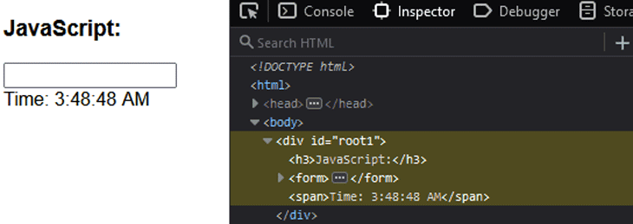
How re-rendering impacts performance
DOM operations are very fast, light operations. However, when the app data changes and triggers an update, re-rendering can be expensive.
Let’s simulate re-rendering a page with the JavaScript code below:
Notes:
1. Virtual DOM
The Virtual DOM is a lightweight, in-memory representation of the real DOM (Document Object Model). It is an abstraction that React uses to optimize updates to the real DOM.
How it works:
When the state of a React component changes, React creates a new Virtual DOM tree.
It compares the new tree with the previous one using a process called diffing.
Only the differences (or deltas) are applied to the real DOM, making updates efficient.
Why it's useful:
Direct manipulation of the real DOM is expensive due to reflows and repaints.
The Virtual DOM minimizes these costly operations, improving performance.
Example: Suppose you update a counter in a React app:
const [count, setCount] = useState(0); return ( <div> <h1>{count}</h1> <button onClick={() => setCount(count + 1)}>Increment</button> </div> );
When the button is clicked, React updates the Virtual DOM with the new value of count (e.g., 1).
React compares the old Virtual DOM tree with the new one, identifies the change in <h1>, and updates only that node in the real DOM.
2. Reconciliation
Reconciliation is the process by which React updates the real DOM to match changes in the Virtual DOM.
Steps:
React creates a new Virtual DOM tree when state or props change.
It compares the new tree with the old one using a process called diffing.
Only the necessary updates are applied to the real DOM.
Why it's efficient: Reconciliation avoids replacing the entire real DOM by identifying and applying only the minimal set of changes.
Example:
If a component adds a new <li> to a list of items: const [items, setItems] = useState(["Item 1", "Item 2"]); return ( <ul> {items.map((item, index) => ( <li key={index}>{item}</li> ))} <button onClick={() => setItems([...items, "Item 3"])}>Add Item</button> </ul> );
React reconciles the DOM, determining that only the new <li> for "Item 3" needs to be added.
3. Diffing
Diffing is the algorithm React uses to identify changes between the old Virtual DOM and the new one.
How it works:
React compares the two trees node by node.
If a node has changed, React updates it in the real DOM.
If a node is removed, React deletes it from the real DOM.
Optimizations: React assumes:
Two elements of different types (<div> vs. <p>) are completely different and re-renders them.
Elements with the same type are compared deeply to find changes in attributes or children.
Example: Suppose you modify a button's text:
<button>Click me</button> → <button>Clicked</button>
React identifies the text change via diffing and updates only the text node inside the <button> element in the real DOM.
Real-World Example (Combining All Concepts)
Suppose you're building a Todo App where you can add or delete tasks:
Initial Render:
The Virtual DOM represents an empty list (<ul></ul>).
React creates the real DOM based on this.
Add Task:
You add a task: "Buy Groceries".
React updates the Virtual DOM with a new <li> node.
During reconciliation, diffing identifies that a new <li> was added and updates the real DOM efficiently.
Delete Task:
You remove the "Buy Groceries" task.
The Virtual DOM removes the corresponding <li> node.
Diffing detects this removal, and React deletes the node from the real DOM.
With these techniques, React ensures your app is fast and responsive, even as the UI becomes more complex.

Slide 28
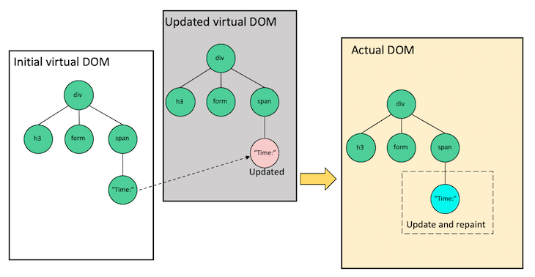
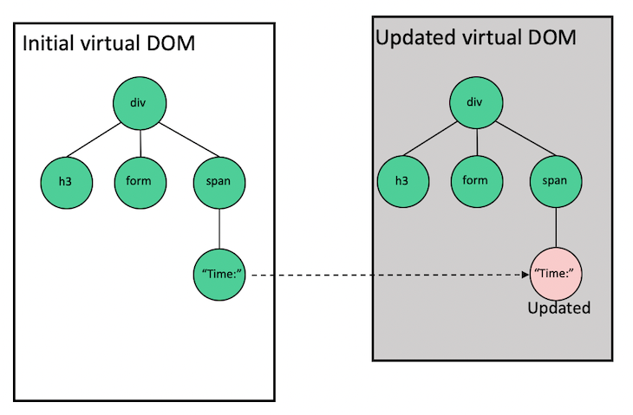
Ho react implements virtual dom
Notes:
To understand the virtual DOM strategy, we need to understand the two major phases that are involved, rendering and reconciliation.
When we render an application user interface, React creates a virtual DOM tree representing that UI and stores it in memory. On the next update, or in other words, when the data that renders the app changes, React will automatically create a new virtual DOM tree for the update. (see image 1)
The image on the left is the initial render. As the Time changes, React creates a new tree with the updated node, as seen on the right side. (image 1)
Remember, the virtual DOM is just an object representing the UI, so nothing gets drawn on the screen.
After React creates the new virtual DOM tree, it compares it to the previous snapshot using a diffing algorithm called reconciliation to figure out what changes are necessary.
After the reconciliation process, React uses a renderer library like ReactDOM, which takes the differ information to update the rendered app. This library ensures that the actual DOM only receives and repaints the updated node or nodes:

Slide 29
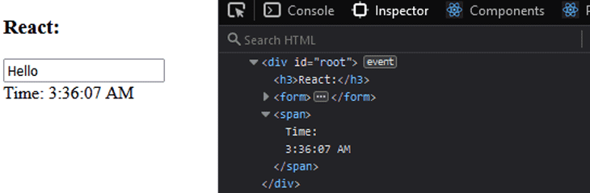
Graphical Representation

Slide 30
Components

Slide 31
React Components
Components are like functions that return HTML elements.
Components are independent and reusable bits of code. They serve the same purpose as JavaScript functions, but work in isolation and return HTML.
Components come in four types, Class components, Function components, Pure Components and High Order Componenets.

Slide 32
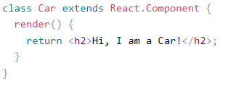
1. Class Components
When creating a React component, the component's name MUST start with an upper case letter.
A class component must include the extends React.Component statement. This statement creates an inheritance to React.Component, and gives your component access to React.Component's functions.
The component also requires a render() method, this method returns HTML.

Slide 33
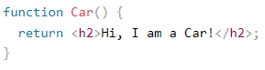
2. Function Component
A Function component also returns HTML, and behaves much the same way as a Class component, but Function components can be written using much less code, are easier to understand.

Slide 34
3. Pure Components
Pure components are like better functional components
pure components perform shallow comparisons on state change
If the previous state and/or props are the same as the next, the component is not re-rendered.
React Components are usually re-rendered when:
setState() is called
props values are updated
forceUpdate() is called
Notes:
But in pure components, the React components do not re-render blindly without considering the updated state and props. Thus, if state and props are the same as the previous state and props , then the component does not re-render. This is very useful when you do not want to re-render a certain component while the props and state remain the same.
For example, you don’t want one component, let’s say a music player, to re-render because another component updates, maybe when you create a playlist. You might want the music player to stay constant at one song and not replay whenever you change a different component’s state or props. Pure components would be very useful in these types of situations.

Slide 35
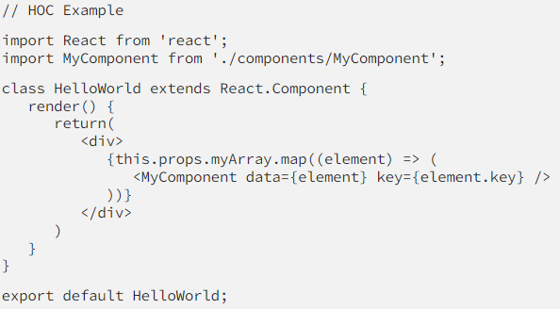
4. Higher order components
Higher-order components(HOC) is an advanced technique in React for reusing component logic
It is not a React component you can find in the API.
Basically, HOCs are functions that return a component(s).

Slide 36
Conclusion
Functional Components — functions that return JSX. Can do more stuff with React Hooks.
Class Components — classes that can manipulate state, props, and lifecycle methods.
Pure Components — functional components that performs shouldComponentUpdate() automatically. Re-renders only if state or props is different from previous state or props.
Higher-Order Components — functions that return one or multiple components, depending on array data.

Slide 37
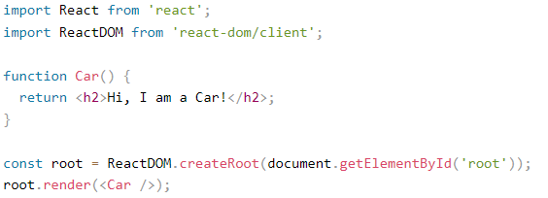
Rendering a Component
Now our React application has a component called Car, which returns an <h2> element.
To use this component in your application, use similar syntax as normal HTML: <Car />

Slide 38
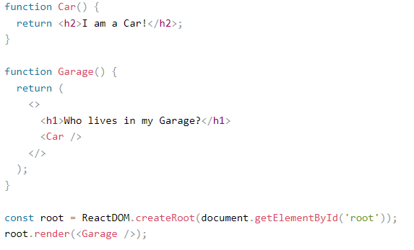
Components in Components

Slide 39
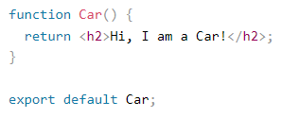
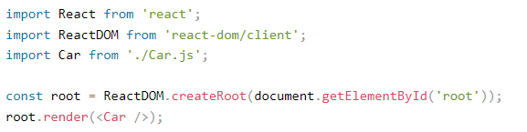
Components in Files
React is all about re-using code, and it is recommended to split your components into separate files.
To do that, create a new file with a .js file extension and put the code inside it:
Car.js

Slide 40
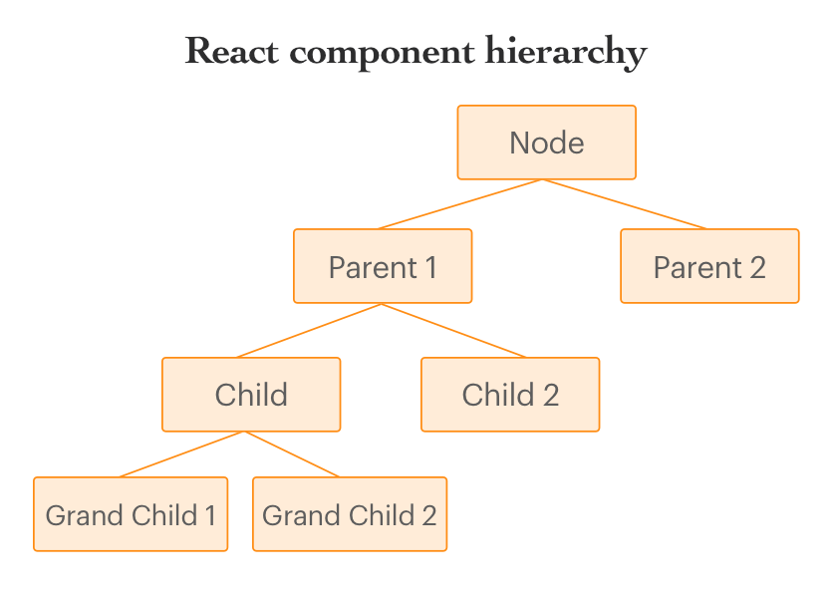
React Componenet Hierarchy

Slide 41
Props

Slide 42
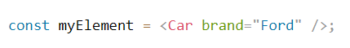
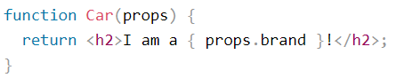
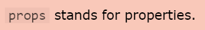
Props
Props are arguments passed into React components.
Props are passed to components via HTML attributes.

Slide 43
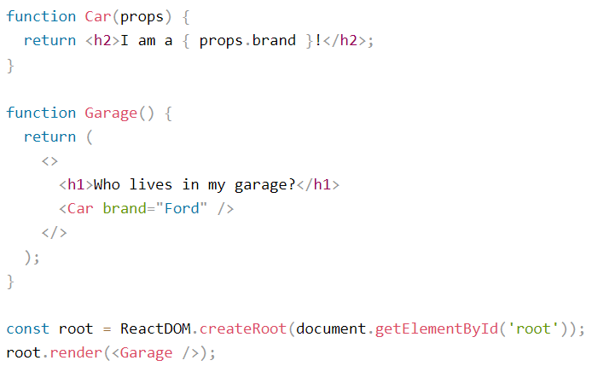
Pass Data
Props are also how you pass data from one component to another, as parameters.

Slide 44
Default props
The defaultProps is a React component property that allows you to set default values for the props argument.
If the prop property is passed, it will be changed.
The defaultProps can be defined as a property on the component class itself, to set the default props for the class.

Slide 45
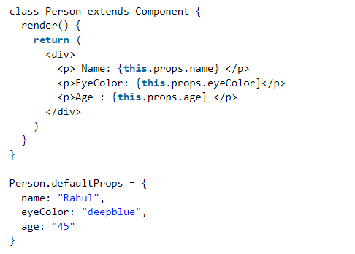
defaultProps example

Slide 46
Events

Slide 47
React Events
Just like HTML DOM events, React can perform actions based on user events.
React has the same events as HTML: click, change, mouseover etc.

Slide 48
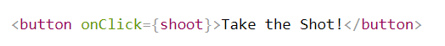
Adding Events
React events are written in camelCase syntax:
onClick instead of onclick.
React event handlers are written inside curly braces:
onClick={shoot} instead of onClick="shoot()".

Slide 49
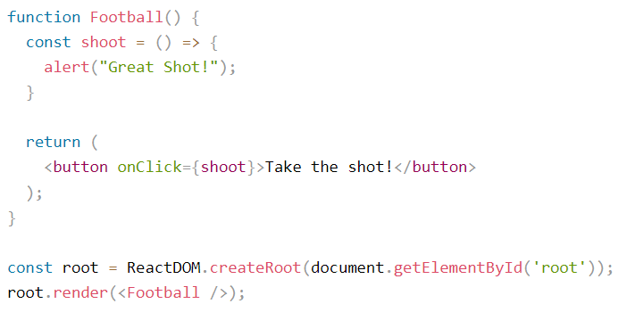
Example

Slide 50
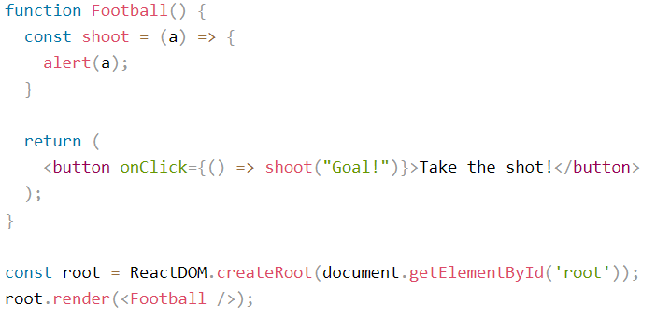
Passing Arguments

Slide 51
React State

Slide 52
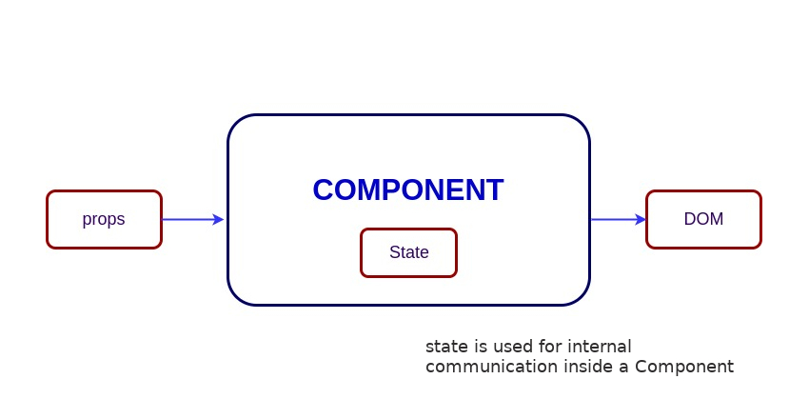
React State
React components has a built-in state object.
The state object is where you store property values that belongs to the component.
When the state object changes, the component re-renders.
Notes:
State should never be updated explicitly

Slide 53
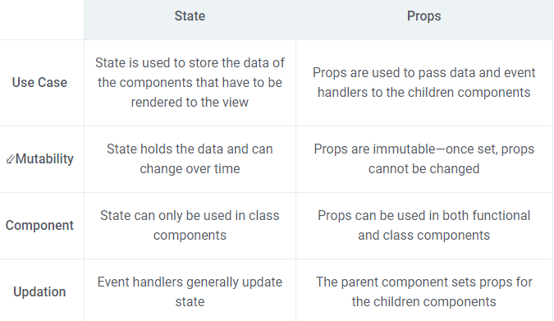
State vs Props

Slide 54
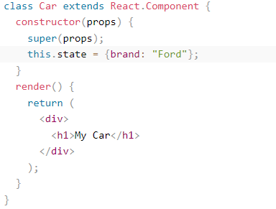
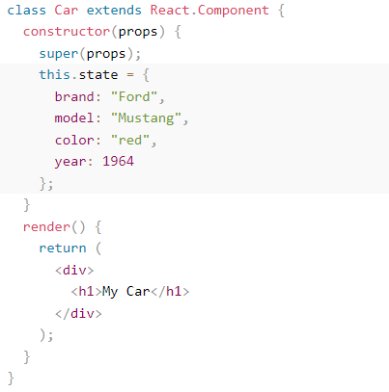
Creating the state Object
The state object is initialized in the constructor:

Slide 55
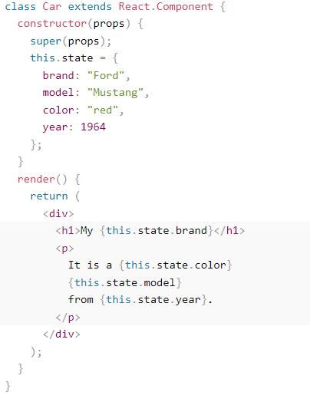
Using the state Object
Refer to the state object anywhere in the component by using the this.state.propertyname syntax:

Slide 56
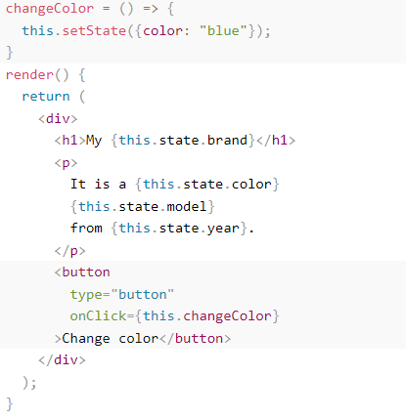
Changing the state Object
To change a value in the state object, use the this.setState() method.
When a value in the state object changes, the component will re-render, meaning that the output will change according to the new value(s).

Slide 57
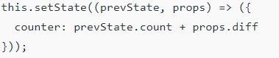
Setstate concerns
React is highly efficient and thus uses asynchronous state updates i.e. React may update multiple setState() updates in a single go.
Thus using the value of the current state may not always generate the desired result.
For example, let us take a case where we must keep a count (Likes of a Post). Many developers may miswrite the code as below.
Now due to asynchronous processing, this.state.count may produce an undesirable result. A more appropriate approach would be to use the following.

Slide 58
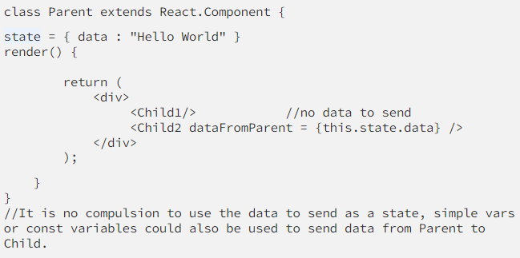
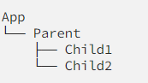
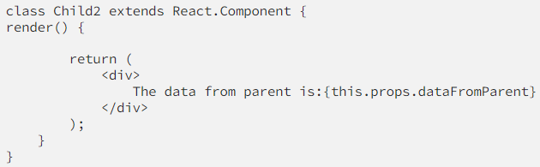
Passing state from parent to child

Slide 59
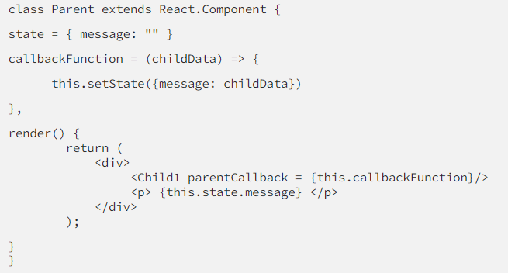

Passing data from child to parent
Step 1: Define a callback function that takes in a parameter which we consider having accessed from the child in the Parent.js
Step 2: Also, send the defined callback function as a props to the Child1.js

Slide 60

Passing data between siblings
Method 1: Combine the above two methods of sharing data.

Slide 61

Passing data between siblings (cont…)
Method 2: Use a global store maintaining the states of all child components which are needed to interact and consume the data required from the store — Redux

Slide 62
React Component Lifecycle

Slide 63
Lifecycle of a component
Each component in React has a lifecycle which you can monitor and manipulate during its three main phases.
The three phases are: Mounting, Updating, and Unmounting.

Slide 64
Mounting
Mounting means putting elements into the DOM.
React has four built-in methods that gets called, in this order, when mounting a component:
constructor()
getDerivedStateFromProps()
render()
componentDidMount()
The render() method is required and will always be called, the others are optional and will be called if you define them.
Notes:
constructor
The constructor() method is called before anything else, when the component is initiated, and it is the natural place to set up the initial state and other initial values.
The constructor() method is called with the props, as arguments, and you should always start by calling the super(props) before anything else, this will initiate the parent's constructor method and allows the component to inherit methods from its parent (React.Component).
class Header extends React.Component {
constructor(props) {
super(props);
this.state = {favoritecolor: "red"};
}
render() {
return (
<h1>My Favorite Color is {this.state.favoritecolor}</h1>
);
}
}
ReactDOM.render(<Header />, document.getElementById('root'));
getDerivedStateFromProps
The getDerivedStateFromProps() method is called right before rendering the element(s) in the DOM.
This is the natural place to set the state object based on the initial props.
It takes state as an argument, and returns an object with changes to the state.
The example below starts with the favorite color being "red", but the getDerivedStateFromProps() method updates the favorite color based on the favcol attribute:
class Header extends React.Component {
constructor(props) {
super(props);
this.state = {favoritecolor: "red"};
}
static getDerivedStateFromProps(props, state) {
return {favoritecolor: props.favcol };
}
render() {
return (
<h1>My Favorite Color is {this.state.favoritecolor}</h1>
);
}
}
ReactDOM.render(<Header favcol="yellow"/>, document.getElementById('root'));
render
The render() method is required, and is the method that actually outputs the HTML to the DOM.
class Header extends React.Component {
render() {
return (
<h1>This is the content of the Header component</h1>
);
}
}
ReactDOM.render(<Header />, document.getElementById('root'));
componentDidMount
The componentDidMount() method is called after the component is rendered.
This is where you run statements that requires that the component is already placed in the DOM.
class Header extends React.Component {
constructor(props) {
super(props);
this.state = {favoritecolor: "red"};
}
componentDidMount() {
setTimeout(() => {
this.setState({favoritecolor: "yellow"})
}, 1000)
}
render() {
return (
<h1>My Favorite Color is {this.state.favoritecolor}</h1>
);
}
}
ReactDOM.render(<Header />, document.getElementById('root'));

Slide 65
Updating
The next phase in the lifecycle is when a component is updated.
A component is updated whenever there is a change in the component's state or props.
React has five built-in methods that gets called, in this order, when a component is updated:
getDerivedStateFromProps()
shouldComponentUpdate()
render()
getSnapshotBeforeUpdate()
componentDidUpdate()
Notes:
getDerivedStateFromProps
Also at updates the getDerivedStateFromProps method is called. This is the first method that is called when a component gets updated.
This is still the natural place to set the state object based on the initial props.
The example below has a button that changes the favorite color to blue, but since the getDerivedStateFromProps() method is called, which updates the state with the color from the favcol attribute, the favorite color is still rendered as yellow:
class Header extends React.Component {
constructor(props) {
super(props);
this.state = {favoritecolor: "red"};
}
static getDerivedStateFromProps(props, state) {
return {favoritecolor: props.favcol };
}
changeColor = () => {
this.setState({favoritecolor: "blue"});
}
render() {
return (
<div>
<h1>My Favorite Color is {this.state.favoritecolor}</h1>
<button type="button" onClick={this.changeColor}>Change color</button>
</div>
);
}
}
ReactDOM.render(<Header favcol="yellow"/>, document.getElementById('root'));
shouldComponentUpdate
In the shouldComponentUpdate() method you can return a Boolean value that specifies whether React should continue with the rendering or not.
The default value is true.
The example below shows what happens when the shouldComponentUpdate() method returns false:
class Header extends React.Component {
constructor(props) {
super(props);
this.state = {favoritecolor: "red"};
}
shouldComponentUpdate() {
return false;
}
changeColor = () => {
this.setState({favoritecolor: "blue"});
}
render() {
return (
<div>
<h1>My Favorite Color is {this.state.favoritecolor}</h1>
<button type="button" onClick={this.changeColor}>Change color</button>
</div>
);
}
}
ReactDOM.render(<Header />, document.getElementById('root'));
Render
The render() method is of course called when a component gets updated, it has to re-render the HTML to the DOM, with the new changes.
The example below has a button that changes the favorite color to blue:
class Header extends React.Component {
constructor(props) {
super(props);
this.state = {favoritecolor: "red"};
}
changeColor = () => {
this.setState({favoritecolor: "blue"});
}
render() {
return (
<div>
<h1>My Favorite Color is {this.state.favoritecolor}</h1>
<button type="button" onClick={this.changeColor}>Change color</button>
</div>
);
}
}
ReactDOM.render(<Header />, document.getElementById('root'));
getSnapshotBeforeUpdate
In the getSnapshotBeforeUpdate() method you have access to the props and state before the update, meaning that even after the update, you can check what the values were before the update.
If the getSnapshotBeforeUpdate() method is present, you should also include the componentDidUpdate() method, otherwise you will get an error.
The example below might seem complicated, but all it does is this:
When the component is mounting it is rendered with the favorite color "red".
When the component has been mounted, a timer changes the state, and after one second, the favorite color becomes "yellow".
This action triggers the update phase, and since this component has a getSnapshotBeforeUpdate() method, this method is executed, and writes a message to the empty DIV1 element.
Then the componentDidUpdate() method is executed and writes a message in the empty DIV2 element:
class Header extends React.Component {
constructor(props) {
super(props);
this.state = {favoritecolor: "red"};
}
componentDidMount() {
setTimeout(() => {
this.setState({favoritecolor: "yellow"})
}, 1000)
}
getSnapshotBeforeUpdate(prevProps, prevState) {
document.getElementById("div1").innerHTML =
"Before the update, the favorite was " + prevState.favoritecolor;
}
componentDidUpdate() {
document.getElementById("div2").innerHTML =
"The updated favorite is " + this.state.favoritecolor;
}
render() {
return (
<div>
<h1>My Favorite Color is {this.state.favoritecolor}</h1>
<div id="div1"></div>
<div id="div2"></div>
</div>
);
}
}
ReactDOM.render(<Header />, document.getElementById('root'));
componentDidUpdate
The componentDidUpdate method is called after the component is updated in the DOM.
The example below might seem complicated, but all it does is this:
When the component is mounting it is rendered with the favorite color "red".
When the component has been mounted, a timer changes the state, and the color becomes "yellow".
This action triggers the update phase, and since this component has a componentDidUpdate method, this method is executed and writes a message in the empty DIV element:
class Header extends React.Component {
constructor(props) {
super(props);
this.state = {favoritecolor: "red"};
}
componentDidMount() {
setTimeout(() => {
this.setState({favoritecolor: "yellow"})
}, 1000)
}
componentDidUpdate() {
document.getElementById("mydiv").innerHTML =
"The updated favorite is " + this.state.favoritecolor;
}
render() {
return (
<div>
<h1>My Favorite Color is {this.state.favoritecolor}</h1>
<div id="mydiv"></div>
</div>
);
}
}
ReactDOM.render(<Header />, document.getElementById('root'));

Slide 66
Unmounting
The next phase in the lifecycle is when a component is removed from the DOM, or unmounting as React likes to call it.
React has only one built-in method that gets called when a component is unmounted:
componentWillUnmount()
Notes:
componentWillUnmount
The componentWillUnmount method is called when the component is about to be removed from the DOM.
class Container extends React.Component {
constructor(props) {
super(props);
this.state = {show: true};
}
delHeader = () => {
this.setState({show: false});
}
render() {
let myheader;
if (this.state.show) {
myheader = <Child />;
};
return (
<div>
{myheader}
<button type="button" onClick={this.delHeader}>Delete Header</button>
</div>
);
}
}
class Child extends React.Component {
componentWillUnmount() {
alert("The component named Header is about to be unmounted.");
}
render() {
return (
<h1>Hello World!</h1>
);
}
}
ReactDOM.render(<Container />, document.getElementById('root'));

Slide 67
Hooks
Still Learning :P

Slide 68
Hooks
Hooks were added to React in version 16.8.
Hooks allow function components to have access to state and other React features. Because of this, class components are generally no longer needed.
Hooks allow us to "hook" into React features such as state and lifecycle methods.

Slide 69

Example

Slide 70
Usage
You must import Hooks from react.
In last example, we are using the useState Hook to keep track of the application state.
State generally refers to application data or properties that need to be tracked.

Slide 71
Hook Rules
Hooks can only be called inside React function components.
Hooks can only be called at the top level of a component.
Hooks cannot be conditional

Slide 72


React useState Hook
The React useState Hook allows us to track state in a function component.
State generally refers to data or properties that need to be tracking in an application.
Initialize useState
useState accepts an initial state and returns two values:
The current state.
A function that updates the state.
Notes:
The first value, color, is our current state.
The second value, setColor, is the function that is used to update our state.

Slide 73

Read State
We can now include our state anywhere in our component.

Slide 74

Update State
To update our state, we use our state updater function.

Slide 75


What Can State Hold
The useState Hook can be used to keep track of strings, numbers, booleans, arrays, objects, and any combination of these!
We could create multiple state Hooks to track individual values.

Slide 76
Updating Objects and Arrays in State
When state is updated, the entire state gets overwritten.
What if we only want to update the color of our car?
If we only called setCar({color: "blue"}), this would remove the brand, model, and year from our state.
We can use the JavaScript spread operator to help us

Slide 77

Example

Slide 78
React useEffect Hooks
The useEffect Hook allows you to perform side effects in your components.
Some examples of side effects are: fetching data, directly updating the DOM, and timers.
useEffect accepts two arguments. The second argument is optional.
useEffect(<function>, <dependency>)

Slide 79

Example

Slide 80
Issues
But wait!! It keeps counting even though it should only count once!
useEffect runs on every render. That means that when the count changes, a render happens, which then triggers another effect.
This is not what we want. There are several ways to control when side effects run.
We should always include the second parameter which accepts an array. We can optionally pass dependencies to useEffect in this array.

Slide 81



Ways to use useEffect

Slide 82

Lets modify the above code

Slide 83
React Router

Slide 84
React Router
Create React App doesn't include page routing.
React Router is the most popular solution:

Slide 85
Add React Router
To add React Router in your application, run this in the terminal from the root directory of the application:

Slide 86
Folder Structure
To create an application with multiple page routes, let's first start with the file structure.
Within the src folder, we'll create a folder named pages with several files: src\pages\:
Layout.js
Home.js
Blogs.js
Contact.js
NoPage.js
Each file will contain a very basic React component.

Slide 87

Basic Usage
Notes:
We wrap our content first with <BrowserRouter>.
Then we define our <Routes>. An application can have multiple <Routes>. Our basic example only uses one.
<Route>s can be nested. The first <Route> has a path of / and renders the Layout component.
The nested <Route>s inherit and add to the parent route. So the blogs path is combined with the parent and becomes /blogs.
The Home component route does not have a path but has an index attribute. That specifies this route as the default route for the parent route, which is /.
Setting the path to * will act as a catch-all for any undefined URLs. This is great for a 404 error page.

Slide 88
Pages / Components
The Layout component has <Outlet> and <Link> elements.
The <Outlet> renders the current route selected.
<Link> is used to set the URL and keep track of browsing history.
Anytime we link to an internal path, we will use <Link> instead of <a href="">.
The "layout route" is a shared component that inserts common content on all pages, such as a navigation menu.

Slide 89

Example : Layout.js

Slide 90




Rest of the files

